Slide 1



ecx.io Frontend Bootcamp — Javascript Day 07 03.08.2021.

Slide 2

Agenda
Data attributes
Interactive elements
Style manipulation

Slide 3


Data attributes

Slide 4
Data attributes
The data-* global attributes form a class of attributes called custom data attributes, that allow proprietary information to be exchanged between the HTML and its DOM representation by scripts.

Slide 5
Data attributes
The data-* global attributes form a class of attributes called custom data attributes, that allow proprietary information to be exchanged between the HTML and its DOM representation by scripts.

Slide 6
Data attributes
All such custom data are available via the HTMLElement interface of the element the attribute is set on.
The HTMLElement.dataset property gives access to them.

Slide 7
Data attributes – data-*
The * may be replaced by any name following the production rule of XML names with the following restrictions:
The name must not start with xml (case-insensitive).
The name must not contain any colon characters (:).
The name must not contain any capital letters.

Slide 8
Data attributes – data-*
Note that the HTMLElement.dataset property is a DOMStringMap.
The name of the custom data attribute data-test-value will be accessible via:
HTMLElement.dataset.testValue
HTMLElement.dataset["testValue"]
As any dash (U+002D) is replaced by the capitalization of the next letter, converting the name to camelcase.

Slide 9
Data attributes – Usage
By adding data-* attributes, even ordinary HTML elements can become rather complex and powerful program-objects.
For example, a space-ship ”sprite” in a game could be a simple <img> element with a class attribute and several data-* attributes:

Slide 10
Data attributes – JS access
Reading the values of these attributes out in JavaScript is also very simple. You could use getAttribute() with their full HTML name to read them, but the standard defines a simpler way: a DOMStringMap you can read out via a dataset property.
To get a data attribute through the dataset object, get the property by the part of the attribute name after data- (note that dashes are converted to camelCase).

Slide 11
Data attributes – CSS access
Note that, as data attributes are plain HTML attributes, you can even access them from CSS. For example to show the parent data on the article you can use generated content in CSS with the attr() function:

Slide 12
Data attributes – CSS access
You can also use the attribute selectors in CSS to change styles according to the data:

Slide 13
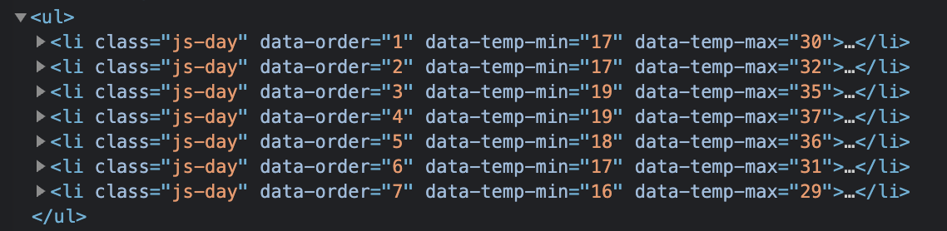
Exercise
Use the temperatures array which holds temperatures for each day from Monday to Sunday and set them as data attributes on the respective list elements in HTML.
It should look like

Slide 14
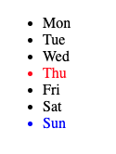
Exercise
Using the solution from the previous exercise, write a selector to query for the list element of the warmest and coolest day (determined by the max temperature). Note: You don’t need to determine the values programmatically, you can hardcode the value in the selector.
The text color for the elements will be set using JavaScript and the output should look like:

Slide 15
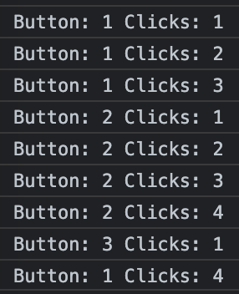
Exercise
Write a click handler for the buttons in the list.
When a button is clicked it’s id should be logged to the console alongside with the count of how many times the button was clicked.
Keep count of the clicks with data attributes. The counter attribute should be called data-click-count.

Slide 16
Interactive Elements

Slide 17
Interactive Elements
Once you've added text, links, and images, you've got most of the basic pieces you're likely see in the websites you visit every day.
However, the last essential components are interactive elements.
Any time you put a username and password into a login field, or press a button to open a menu, or click a checkbox on a settings page, you're dealing with interactive elements such as buttons and inputs.

Slide 18
Buttons
The <button> HTML element represents a clickable button, used to submit forms or anywhere in a document for accessible, standard button functionality. By default, HTML buttons are presented in a style resembling the platform the user agent runs on, but you can change buttons’ appearance with CSS.
Notes:
https://developer.mozilla.org/en-US/docs/Web/HTML/Element/button

Slide 19
Buttons - Events
click
dblclick
Notes:
https://developer.mozilla.org/en-US/docs/Web/HTML/Element/button

Slide 20
Input
The <input> HTML element is used to create interactive controls for web-based forms in order to accept data from the user; a wide variety of types of input data and control widgets are available, depending on the device and user agent. The <input> element is one of the most powerful and complex in all of HTML due to the sheer number of combinations of input types and attributes.

Slide 21
Input - Types
button
checkbox
color
date
datetime-local
email
file
hidden
image
month
number
password
radio
range
reset
search
submit
tel
text
time
url
week

Slide 22
Input - Events
click
dblclick
focus
blur
keydown
keyup

Slide 23
Exercises
TBD

Slide 24
Style Manipulation

Slide 25
Style Manipulation
In order to make our HTML documents interactive we very often manipulate the styles, be it with CSS and pseudo selectors or JavaScript.
Most often done in JavaScript is adding, removing or toggling classes as well as adding inline styles.

Slide 26
Style Manipulation Element.classList
The Element.classList is a read-only property that returns a live DOMTokenList collection of the class attributes of the element. This can then be used to manipulate the class list.

Slide 27
Style Manipulation DOMTokenList
The DOMTokenList interface represents a set of space-separated tokens.
Methods:
add()
contains()
remove()
toggle()
…
Notes:
https://developer.mozilla.org/en-US/docs/Web/API/DOMTokenList

Slide 28
Exercises
TBD

Slide 29
Thank you
© Copyright IBM Corporation 2021.
All rights reserved. The information contained in these materials is provided for informational purposes only, and is provided AS IS without warranty of any kind, express or implied. Any statement of direction represents IBM’s current intent, is subject to change or withdrawal, and represent only goals and objectives. IBM, the IBM logo, and ibm.com are trademarks of IBM Corp., registered in many jurisdictions worldwide. Other product and service names might be trademarks of IBM or other companies.
A current list of IBM trademarks is available at Copyright and trademark information.

